Slide 1

5-Year Oscar
Database
Chang Jing
Rongzhong Li
Weiwei Ge

Slide 2
Outline
Schema
Data source
Database
Sample query
PHP Interface

Slide 3
Schema Design
Awards:
AwardId -> Title, Year, MovieId
Director:
DirectorId --> DirectorName, Gender, Birthday, Race, AwardId
Movie:
MovieId --> MovieName, Year, DirectorId, StarringId, GenreId, CompanyId , AwardId, DirectorId,
Starring
StarringId --> StarringName, Gender, Birthday, Race
Genre
GenreId --> GenreName
Company
CompanyId --> CompanyName, Location, CEO

Slide 4
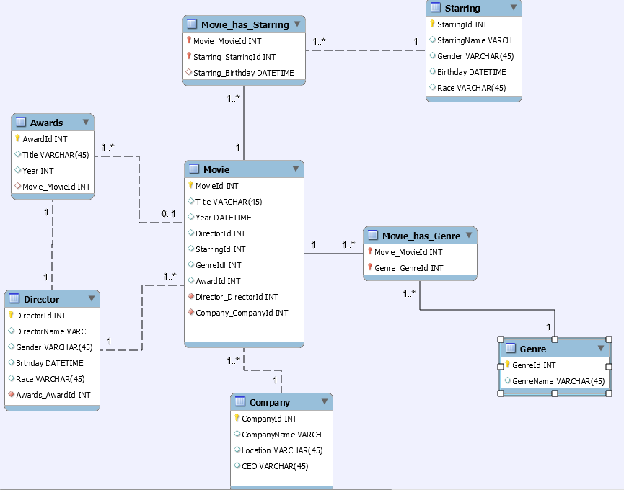
E-R Diagram

Slide 5
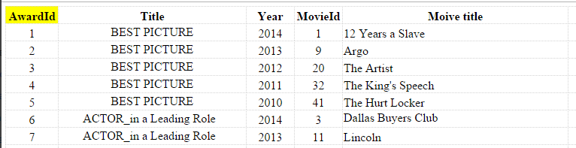
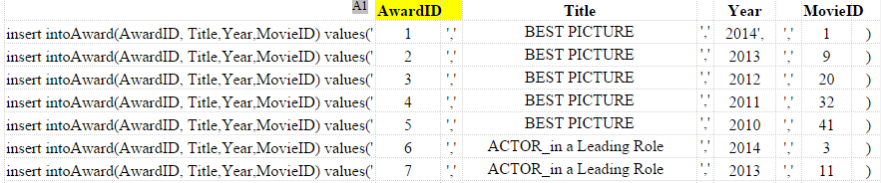
Database
All the data required are handy by googling
The raw data are first organized in a excel file
Then imported to the database using MySQL workbench

Slide 6
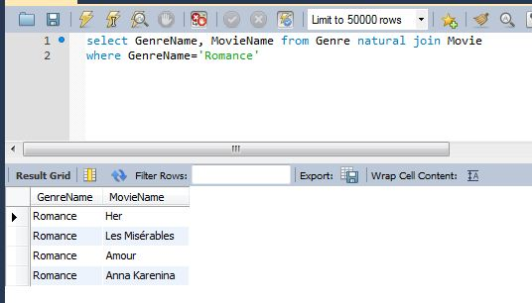
Sample Query 1 on MySQL Workbench
Find the Movie in Romance genre

Slide 7
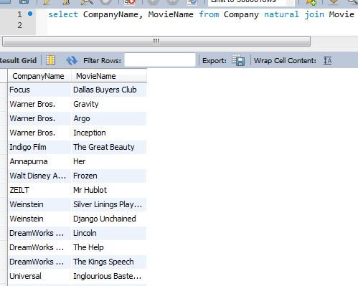
Sample Query 2 on MySQL Workbench
Find the movies produced by the same company.

Slide 8
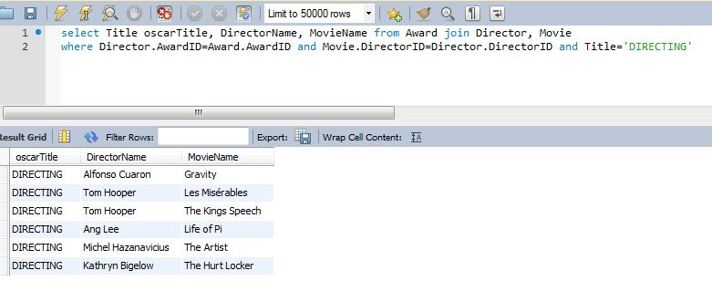
Sample Query 3 on MySQL Workbench
Find the directors who won the Directing Award with their movies.

Slide 9
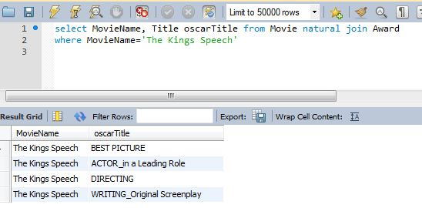
Sample Query 4 on MySQL Workbench
Find the Awards won by “The Kings Speech”.

Slide 10
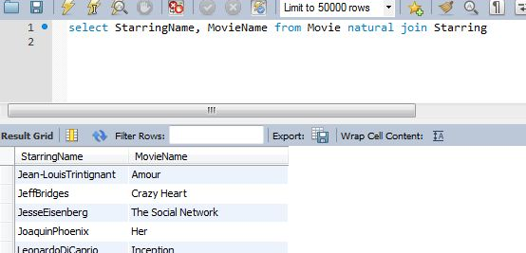
Sample Query 5 on MySQL Workbench
Show the actors/actress with their movies.

Slide 11
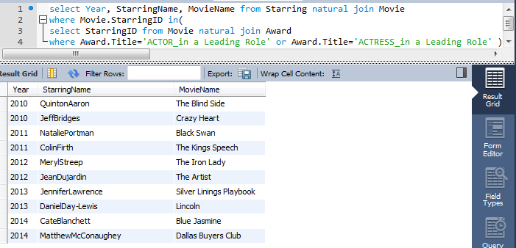
Sample Query 6 on MySQL Workbench
Show the Best Actor/Actress Awards

Slide 12
PHP Interface
Easy to access
http://csc321-ubun64amp.cs.wfu.edu/~groupc/OscarHome.php

Slide 13

Thank You for Your Attention!

